Slide 1
OPERATING SYSTEM (IT-204) PROJECT
SUBMITTED BY:-- SUBMITTED TO :---
VARUN KUMAR (2K19/IT/140) Mr . Jasraj Meena
YASHIT KUMAR (2K19/IT/149)

Slide 2
ADDING SYSTEM CALL IN XV6 OS

Slide 3
INTRODUCTION
In computing, a system call is the programmatic way in which a computer program requests a service from the kernel of the operating system it is executed on. A system call is a way for programs to interact with the operating system.
System call provides the services of the operating system to the user programs via Application Program Interface(API)

Slide 4
System calls are the only entry points into the kernel system. All programs needing resources must use system calls.
The idea of the project is to add system calls to the Linux Kernel xv6 developed by MIT UNIVERSITY .

Slide 5
System Requirements
Operating System=> Linux xv6 developed by MIT University.
Virtual Box
Quick Emulator (QEMU)
Language Used=> C

Slide 6
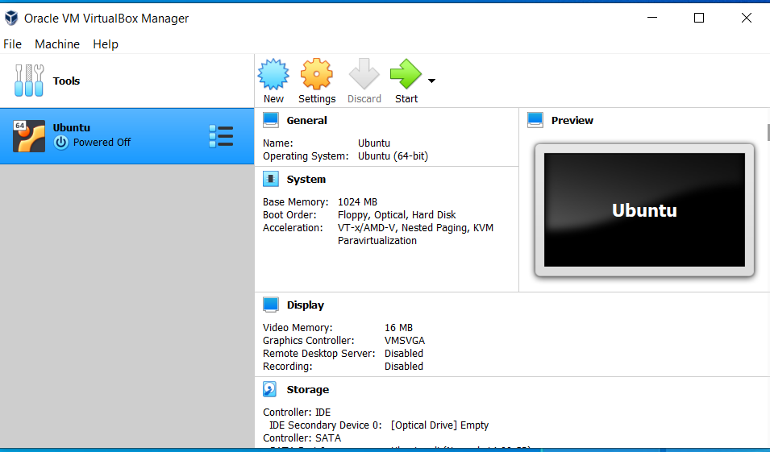
VIRTUAL BOX LINUX

Slide 7
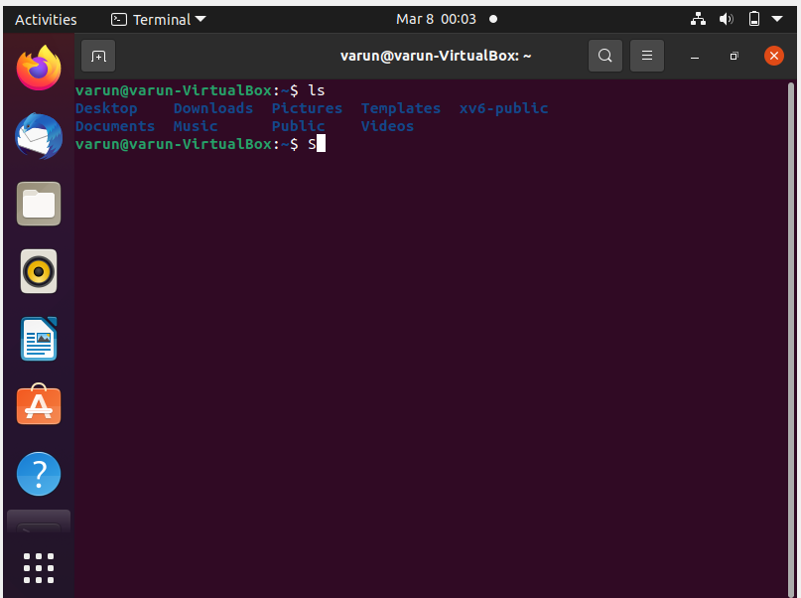

Slide 8
LINUX XV6 OS
xv6 is a modern reimplementation of Sixth Edition Unix in ANSI C for multiprocessor x86 and RISC-V systems
This is a lightweight operating system where the time to compile is very low.
Xv6 is a teaching operating system developed in the summer of 2006 for MIT
Developer | MIT
Written in | C and assembly
OS family | Unix-like
Source model | Open source

Slide 9
